Slide 1
Optimization N Queen Problem using Genetic Algorithm
GUIDE
Prof. Dr. D. M. Ujalambkar
PRESENTED BY
Sarthak Nilesh Thorat
Suraj Nandlal Shirude
Hitesh Pankaj Saswadkar
Pratik Rajendra Karhekar
Vishal Dadasaheb Tanawade
1

Slide 2
Introduction
Genetic Algorithm (GA) is a search-based optimization technique based on the principles of Genetics and Natural Selection.
It is frequently used to find optimal or near-optimal solutions to difficult problems which otherwise would take a lifetime to solve.
It is frequently used to solve optimization problems, in research, and in machine learning.
2

Slide 3
How Genetic Algorithm Works?
A random candidate solutions is created and the fitness scores of the individuals are calculated and the We rank that solutions based on fitness score.
Certain number of chromosomes will pass onto the next generation depending on a selection operator.
Selected chromosomes acting as parents will take part in crossover operation to create children whose fitness values are to be calculated simultaneously.
Mutation operator is applied on new individuals which randomly changes few chromosomes. Mutation probability is generally kept low.

Slide 4
N-Queens problem Definition
Place N queens on an N*N board so that no queen is attacking another queen.
A queen can move horizontally, vertically, or diagonally.
The problem can be solved with genetic algorithm for a n queens problem. (n is between 8 and 30)
Here N=8
4

Slide 5
Software & Hardware Requirement
Hardware:
4 GB RAM
1 TB HDD
Windows OS
Software:
Windows OS
Jupyter Notebook
Python and some libraries
5

Slide 6
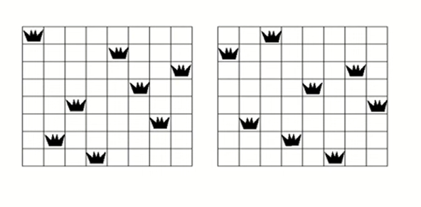
Population
Collection of All States that we consider for solving our problem.
6

Slide 7
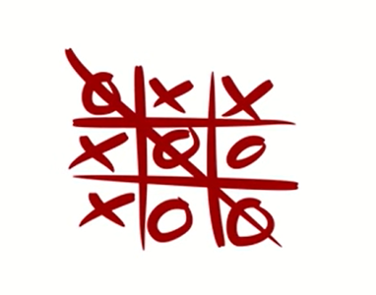
Fitness
It is solutions which is closest to the final solution.
We calculate the fitness of solution and select only those solution whose fitness is high.
7

Slide 8
Selection
Selecting states that are closest to the solution (Fittest).
8

Slide 9
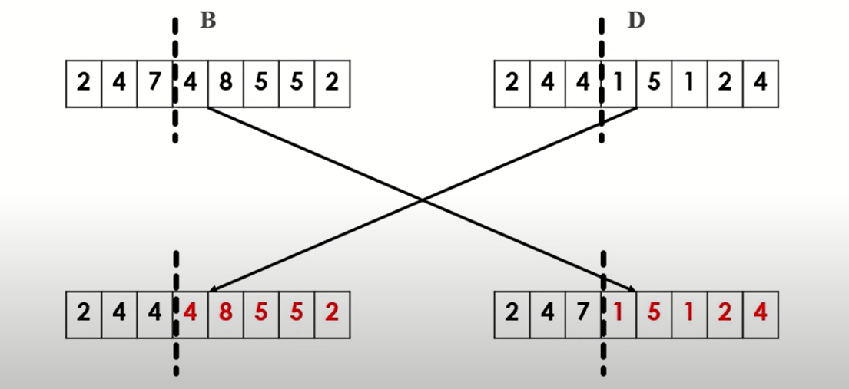
Crossover
We interchange the values between selected state.
9

Slide 10
Mutation
In this values are changed randomly like DNA in Biology.
We can change any number of states to any value.
Before Mutation
After Mutation
1 | 0 | 0 | 1 | 1 | 0
1 | 1 | 1 | 0 | 1 | 1
10

Slide 11
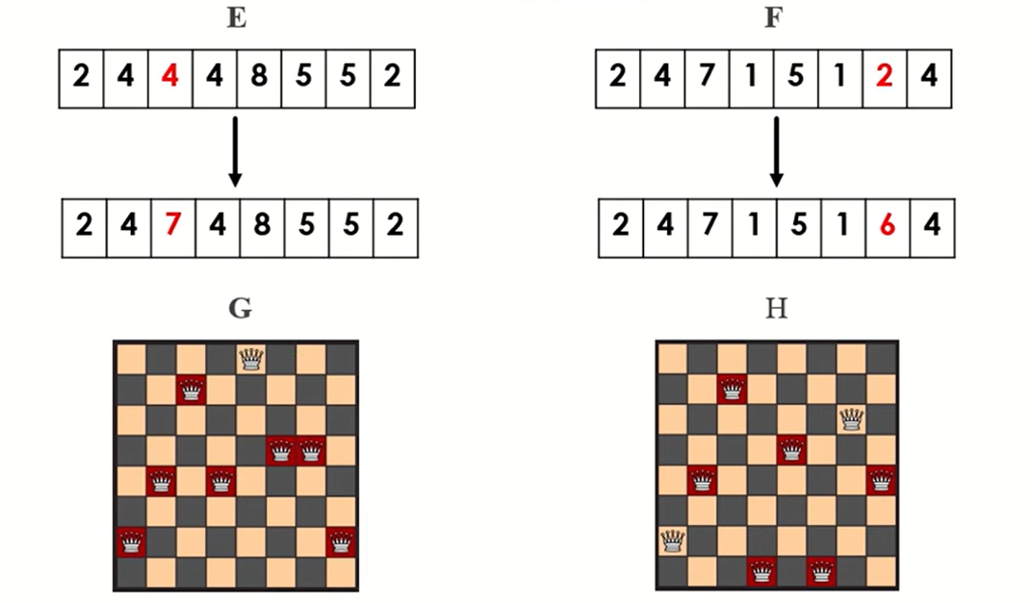
Mutation (Cont.)
We change any random values, But changes should be made on both the sides
11

Slide 12
In n Queens…..
A gene is a number between 0 to n-1.
Is a position of any queen in the board
A chromosome is an array of these genes. It could be the solution.
Population is a generated set of chromosomes.
12

Slide 13
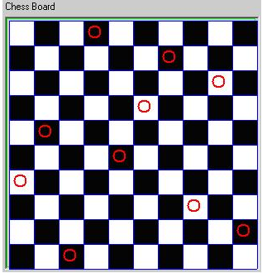
Chromosomes and genes
A chromosome (array of genes. It could be an answer)
{3,6,8,5,1,4,0,7,9,2}
{7,6,9,5,1,4,0,3,8,2}
{9,6,1,5,8,4,0,7,3,2}
{6,3,8,5,2,4,0,7,9,1}
{3,6,8,5,1,4,0,7,9,2}
Population
Gene
Here N=10
13

Slide 14
Steps to Solve N Queen Problem
Representing individuals .
Generating an initial Population.
Apply Fitness Function
Selecting parents for mating in accordance to their fitness.
Crossover of parents to produce new generation
Mutation of new generation to bring diversity.
14

Slide 15
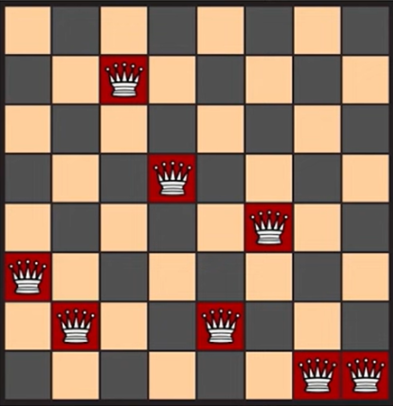

1. Representing Individual
Use an appropriate method to represent individuals of population.
Array:
Index: Column
Value: Row
15

Slide 16
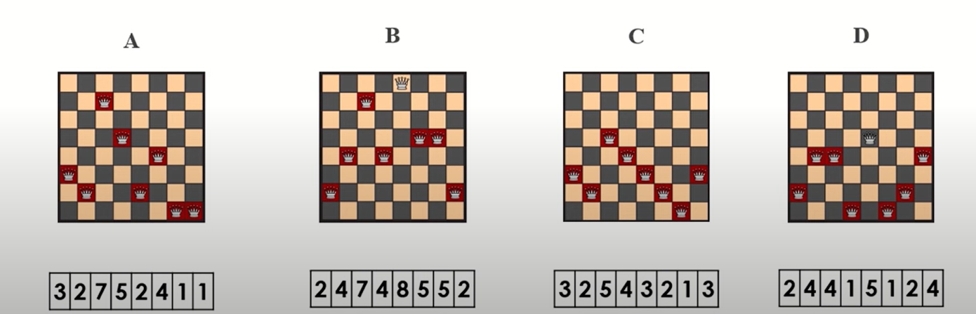
2. Generate Initial States
Generate random arrangement of 8 queens on a standard chess board
16

Slide 17
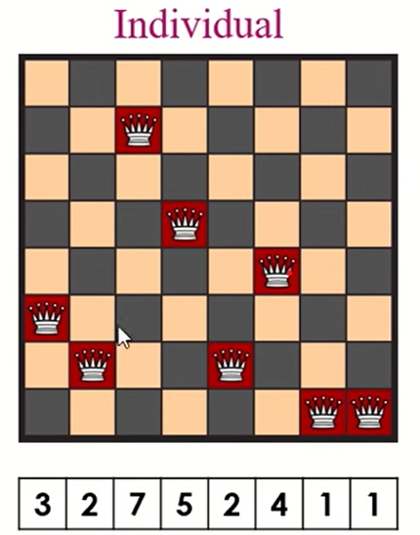
3. Apply Fitness Function
Fitness of each Queen:
Q1= 6
Q2= 5
Q3= 4
Q4= 3
Q5= 3
Q6= 2
Q7= 0
Q8= 0
Total=23
We calculate Fitness of each solution.
Fitness = Number of non attacking pairs.
17

Slide 18
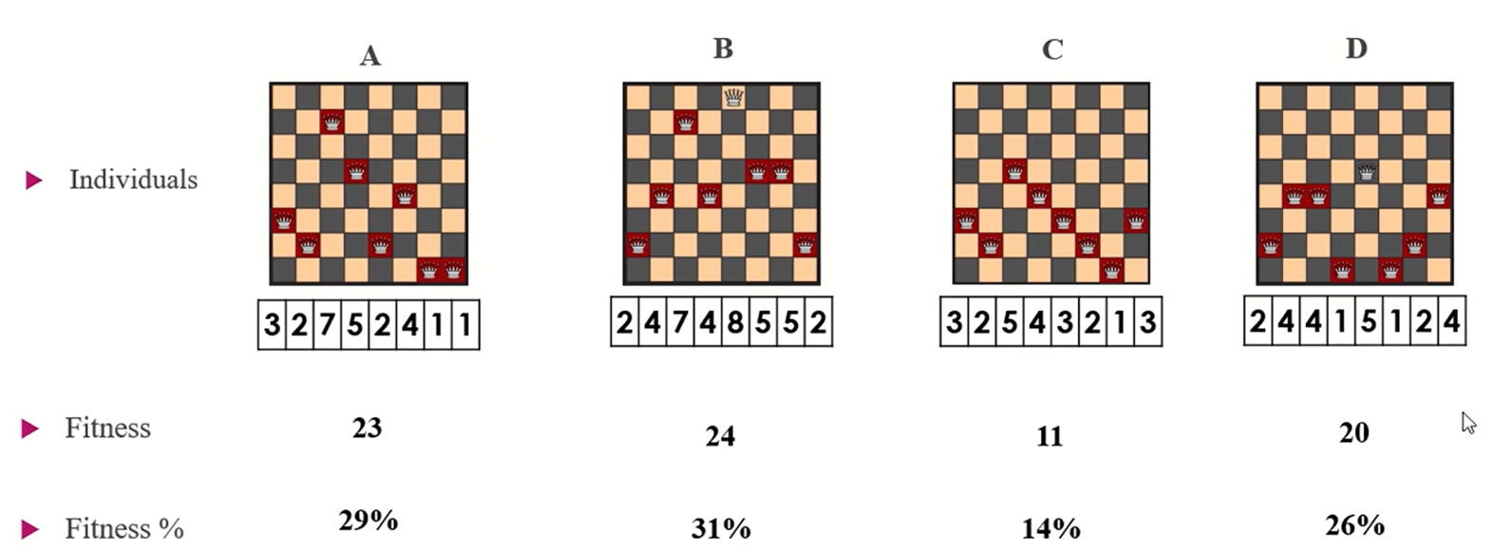
Apply Fitness Function (Cont.)
18

Slide 19
Next Steps :
Step 4: we select some random values
Step 5: apply crossover on it.
Step 6: we apply mutation on it.
Step 7: Repeat all this steps until best solution is reached.
19

Slide 20
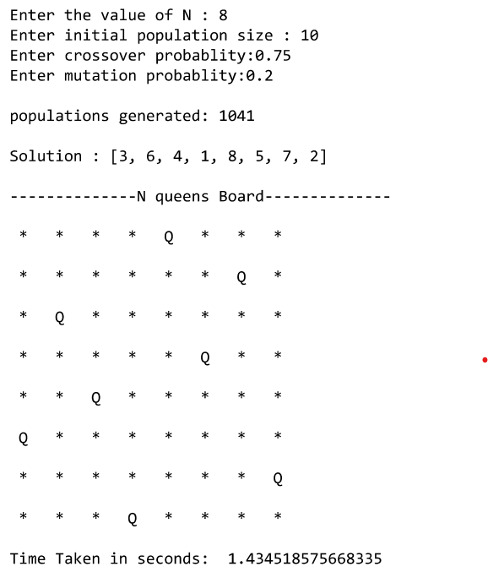
Result
In this snapshot we used 8 Queen .
We used initial population size as 10.
We used crossover probability = 0.75 and mutation probability = 0.2.
20

Slide 21
ADVANTAGES
Is faster and more efficient as compared to the traditional methods.
GA is good for noisy environment.
GA uses probabilistic transition rule, not deterministic rules.
GA is easily parallelised.
21

Slide 22
Disadvantages
GA is computationally expensive some time.
GAs are not suited for all problems, especially problems which are simple and for which derivative information is available.
If not implemented properly, the GA may not converge to the optimal solution.
22

Slide 23
THANK YOU
23

